Slide 1

SKYNET
Big Data Road Map
Team Black Panther
11th December 2016
SkyNet Analysis & Use cases
Notes:
CEO – Phil
COO – Cliff
R&B - Shally

Slide 2
Agenda
Understanding Skynet business opportunities
Use Cases
Capability Assessment
Proposed Roadmap and Summary

Slide 3
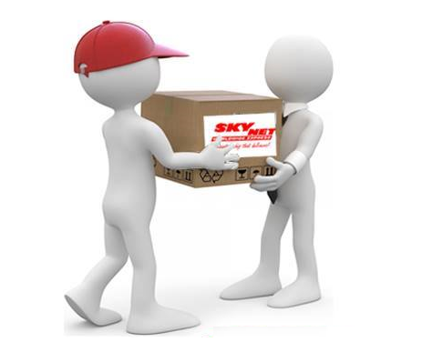
Skynet Business Opportunities
Existing Business :
Makes aviation radio receivers for fixed base operators
Potential new business areas :
Deploying ADS-B Transponders in aircrafts
Leveraging data from Receivers

Slide 4
Key Identified Use Cases

Slide 5
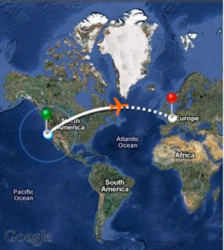
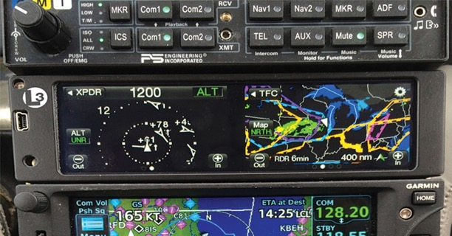
Use Case 1
Identifying the target airliners for installing ADS-B transponders
A pilot project for validation of
the data usability
The analytical concept
Outputs
Recommendation of aircraft types for Transponder certification
Target list of airlines with highest propensity to buy the Transponder

Slide 6
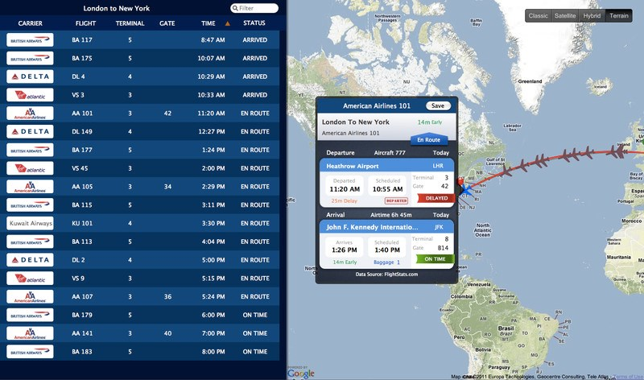
Use Case 2
Real Time Flight Information
Receivers when installed national wide can provide a comprehensive picture of air traffic
This data will be SkyNet proprietary and can be monetized
Outputs:
Portal providing the flight data for a fee
Mobile Application providing access to the data via smart phones

Slide 7
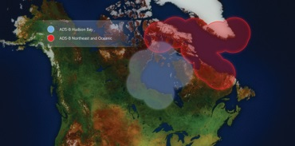
Use Case 3
Marketing platform for growing the Transponder business and for distribution of other airline related products
The data from the Use Case 2 can be used for further enhancement of the analytical application build for Use Case 2
Available data can be used for other marketing activities within the airline industry
Outputs:
Recommendation engine (Aircraft, Airline) will be build to define a market penetration strategy for the Transponder business

Slide 8
Capability Assessment

Slide 9
Solution Outline
Development of an analytical model for “Target Aircrafts and Airlines”
Using available Receiver Data
Enhancing the data with publicly available information
Building and analytics for the target lists for aircrafts and airlines
Building a Data Collection and Distribution Platform
Install the Receivers national wide using the relationship with FBOs
Establish a data collection process for installed Receivers network
Build an analytical process (Data Product)
Develop a distribution model for the Data product
Setting up an “Airline Marketing Engine”
Leverage the national wide Receiver dataset for building a broader data base of Airlines in need to install Transponder
Set up a marketing a communication system and process to continuously identify aircraft without Responders
Use the data to develop and market new products

Slide 10
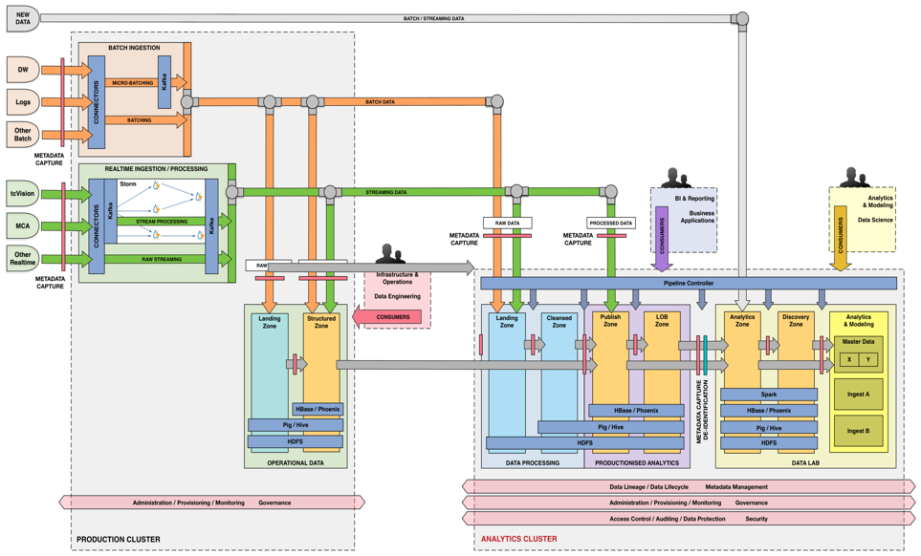
Technical Solution
The target solution requires a robust and scalable architecture based on the Think Big technical concept and following three key functions:
Publishing and Distribution back-end
Data collection and Ingestion process
Actionable Analytics
The solution will be built in cloud

Slide 11
Proposed Roadmap

Slide 12
Solution Roadmap
Business functionalities (Use Cases)
Use Case 1 (Target Lists)
Use Case 2 (Data Monetization)
Use Case 3 (Marketing Platform)
Analytical Model
Data Processing Platform
Marketing Engine
Technical Capabilities
6 weeks
24 weeks
12 weeks

Slide 13
Financial Summary
 | Use Case 1 | Use Case 2 | Use Case 3
Investments - Internal – Think Big Services | 2,000,000 90,000 | 100,000 900,000 | 20,000,000 450,000
Revenues
Transponder sale (90% GM) | 2,115,000 (47) |  | 45,000,000 (1000)
Portal subscription |  | 2,400,000 (200 x12)
Mobile App Sales |  | 5,000,000 (1M)
ROI | N/A | 740% | 220%
All numbers are in USD
The details behind the calculation shall be disclosed in our commercial proposal
Please note that the above financial projections do not include any internal and external operating expenditures

Slide 14

Your Questions

Slide 16
Data Flow
ADS-B
Data Ingestion
Cleansing
Storage & Processing
Ground Receiver
Data Analysis
Other Data Sources

